Slide 1
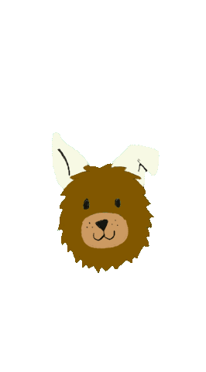
YipYap
Project Architecture

Slide 2
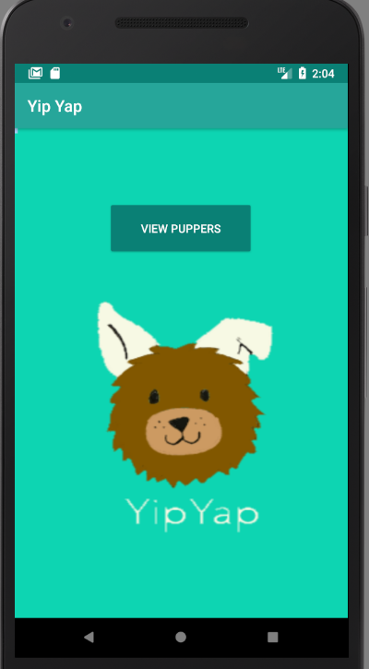
Home Page
Logo and “View Puppers” button
Button takes user to the feed page
Color edited to match theme
Logo Credits: Irena Roggeveen and Genny Norman

Slide 3
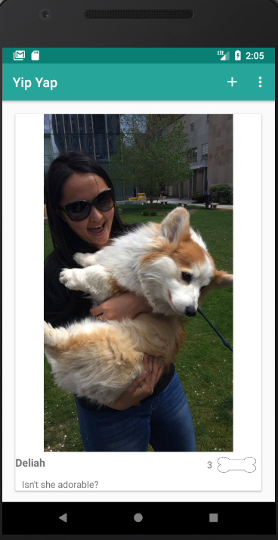
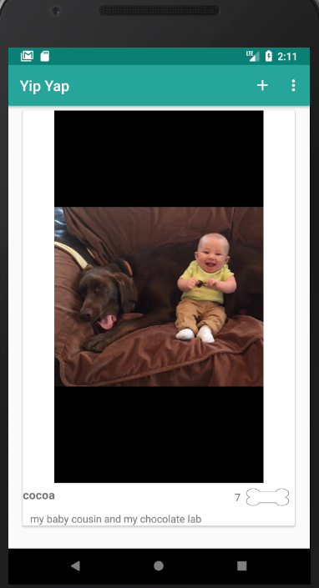
Feed page
Add photo option in upper right corner
Scroll for feed of dog photos
Like button, comment, and title for each photo
Number of likes is stored in Google Firebase

Slide 4
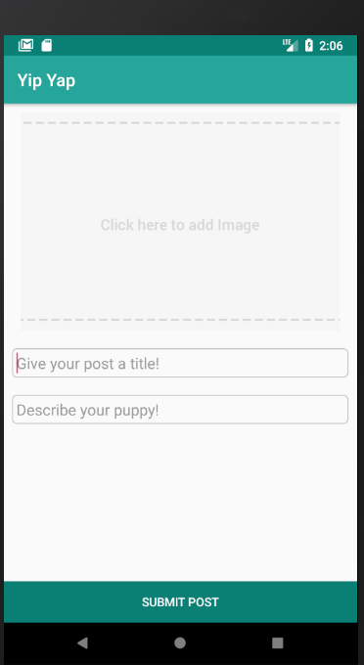
New post
Add photo from photo album, google photos, etc.
Add title and comment to photo
Photo and text are stored in a database and then retrieved and printed to the feed

Slide 5
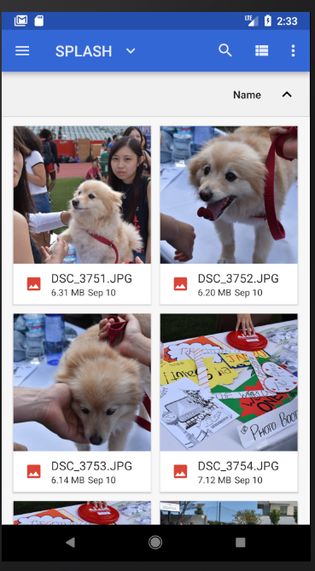
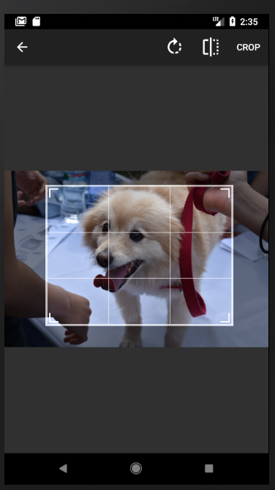
Gallery/Cropping
Offers option to choose a picture from gallery (on-click from image button) or from Google Photos Account
Option to crop is implemented using an API

Slide 6

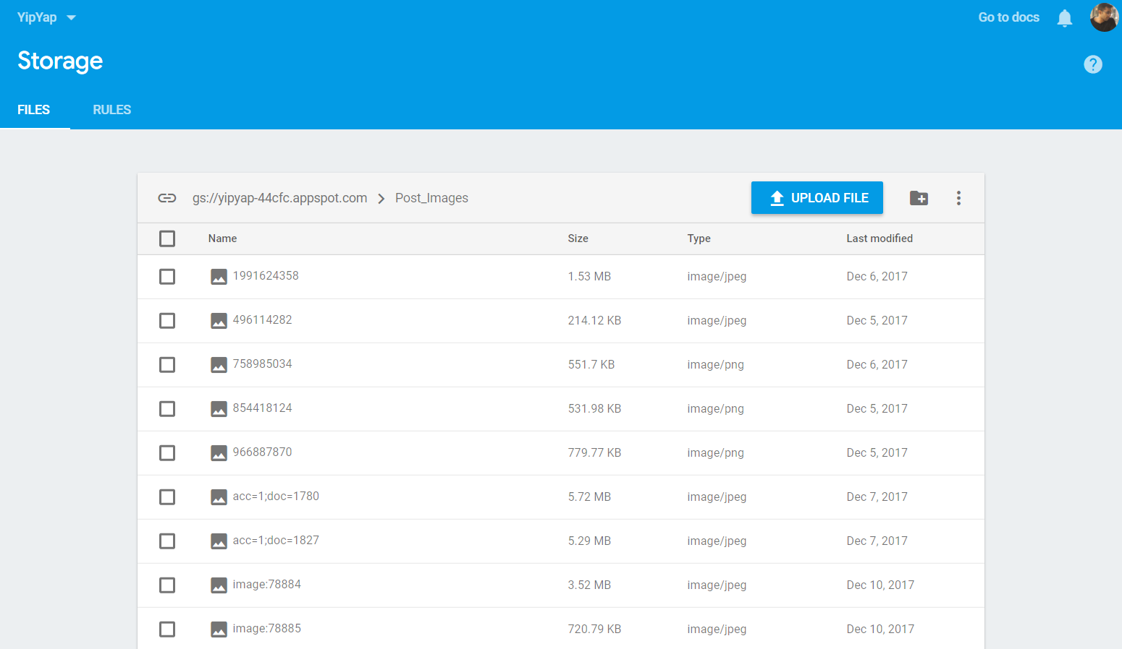
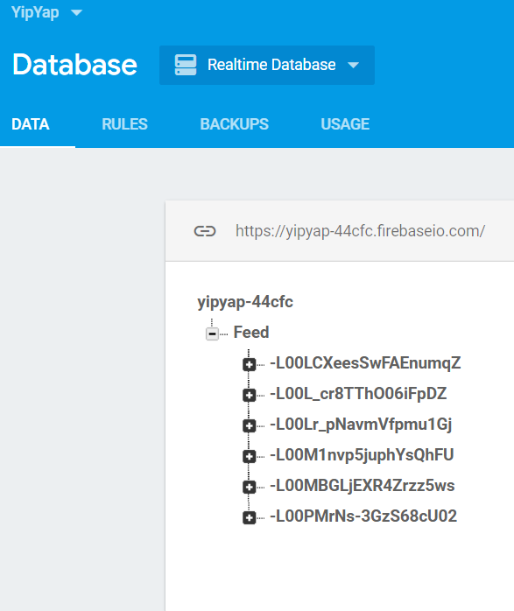
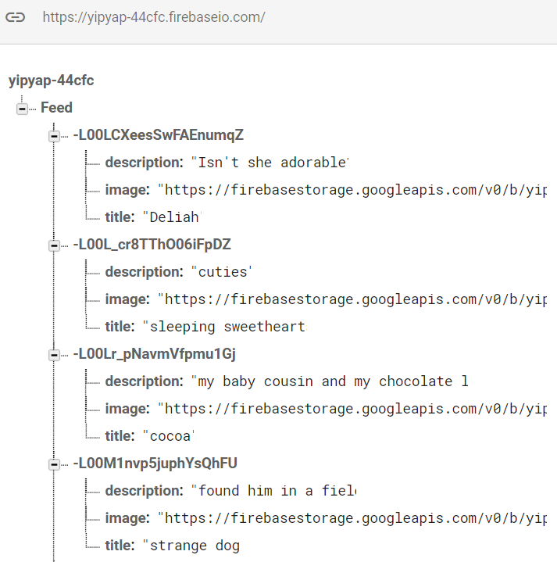
Firebase
Photo, title, and description collected from user is stored on Google Firebase
Simple management and storage of data
Anonymous users, therefore user authentication not required

Slide 7
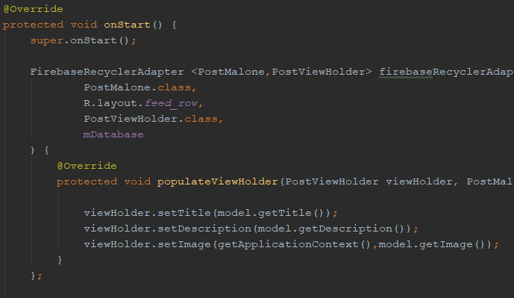
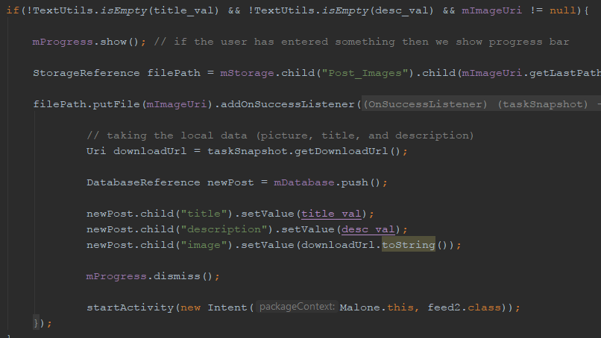
Code
Example 1
App was created in Android Studio using the Java programming language
Example 1 shows how FirebaseRecyclerAdapter was used to populate view using the data that was entered
Example 2 displays how user data is error-checked and relayed from gallery to database to feed
Example 2

Slide 8
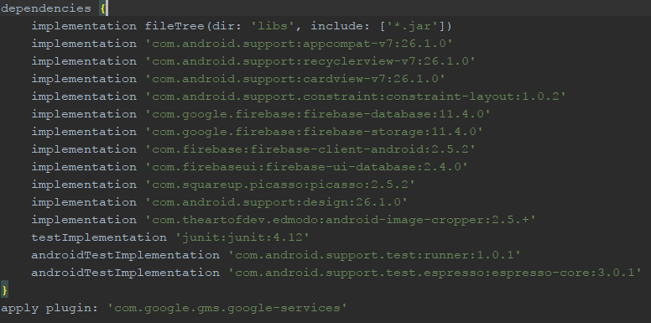

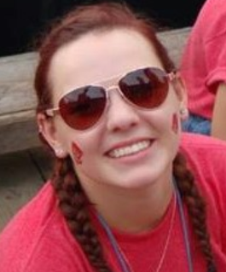
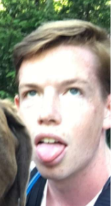
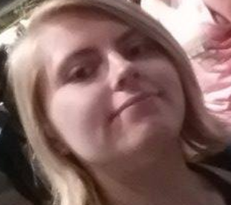


APIs, Libraries, Dependencies, and more
We utilized various sources to put this app together
Google Firebase: for data storage
Picasso (Android) Library & Cropping API: to crop and display image
Youtube: to learn the basics of Android Studio
+
Huge thank you to PROFESSOR DENSMORE AND ALL THE WONDERFUL EC 327 TAs for believing that we can make an app!!!

